Slide 1
Predicting prognosis types
Only selected tumour regions.
16 train patients
5 validation patients
DOD vs Other
2-year survival

Slide 2
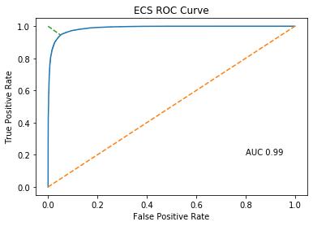
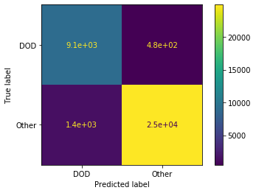
Predicting DOD (Died of disease) vs other

Slide 3
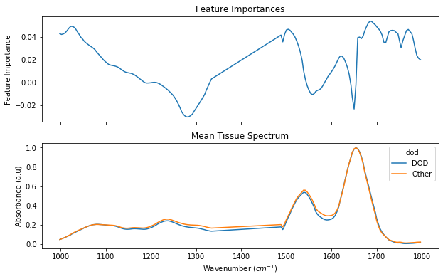
Predicting DOD (Died of disease) vs other

Slide 4
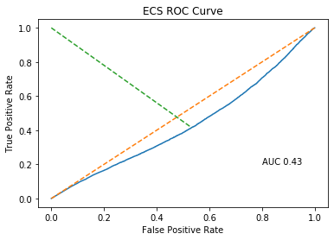
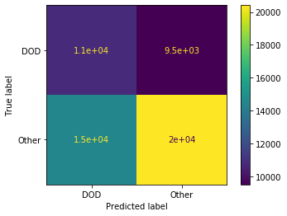
Predicting DOD (Died of disease) vs other

Slide 5
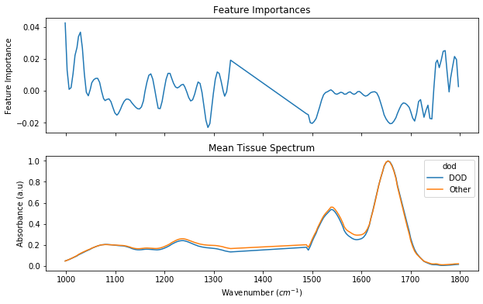
Predicting DOD (Died of disease) vs other

Slide 6
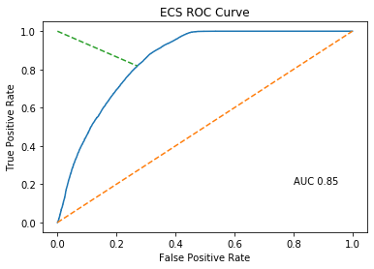
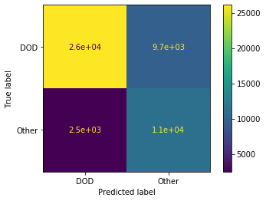
Predicting DOD (Died of disease) vs other

Slide 7
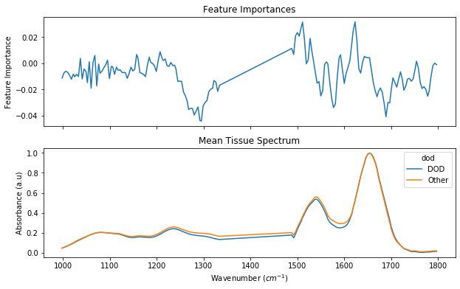
Predicting DOD (Died of disease) vs other

Slide 8
2-Year survival

Slide 9
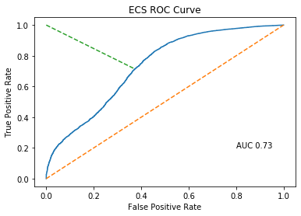
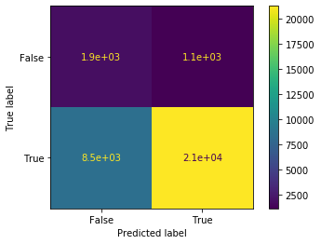
Predicting 2-Year survival

Slide 10
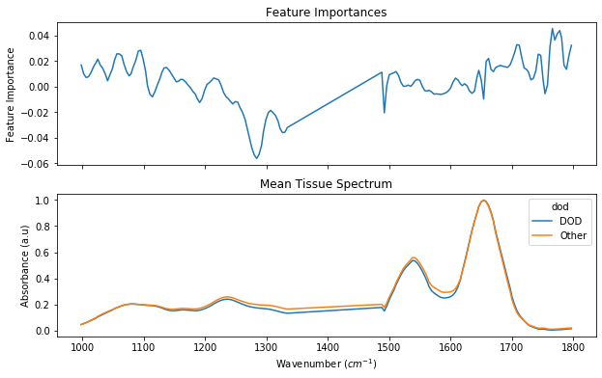
Predicting 2-Year survival

Slide 11
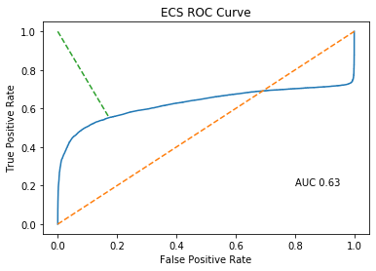
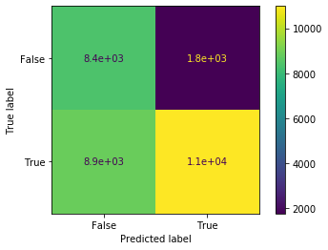
Predicting 2-Year survival

Slide 12
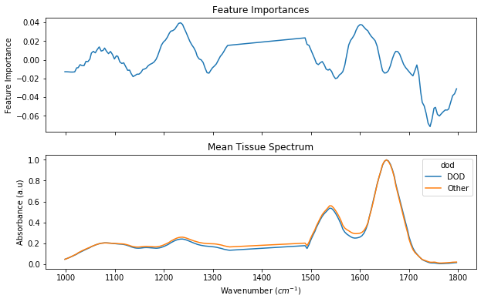
Predicting 2-Year survival

Slide 13
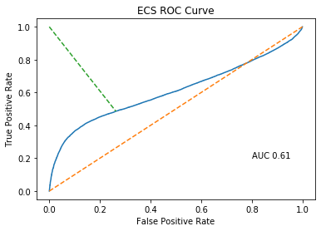
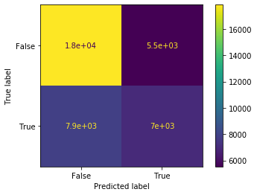
Predicting 2-Year survival

Slide 14
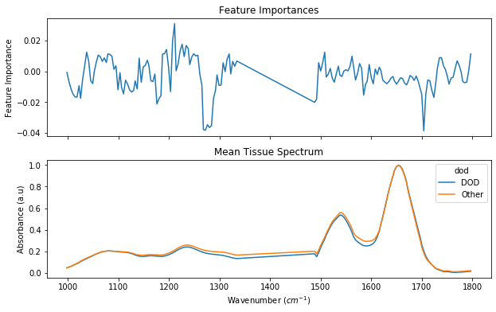
Predicting 2-Year survival

